Slide 1


Construction Mortgage Loans www.newcenturybankna.com
Alan Lierz, President CEO
Mortgage Lending as it pertains to building a new home
Explaining the construction lending process
Answer common questions
Provide solutions When you see our logo, look for the client solution
Today we’ll move one step closer to realizing a dream

Slide 2
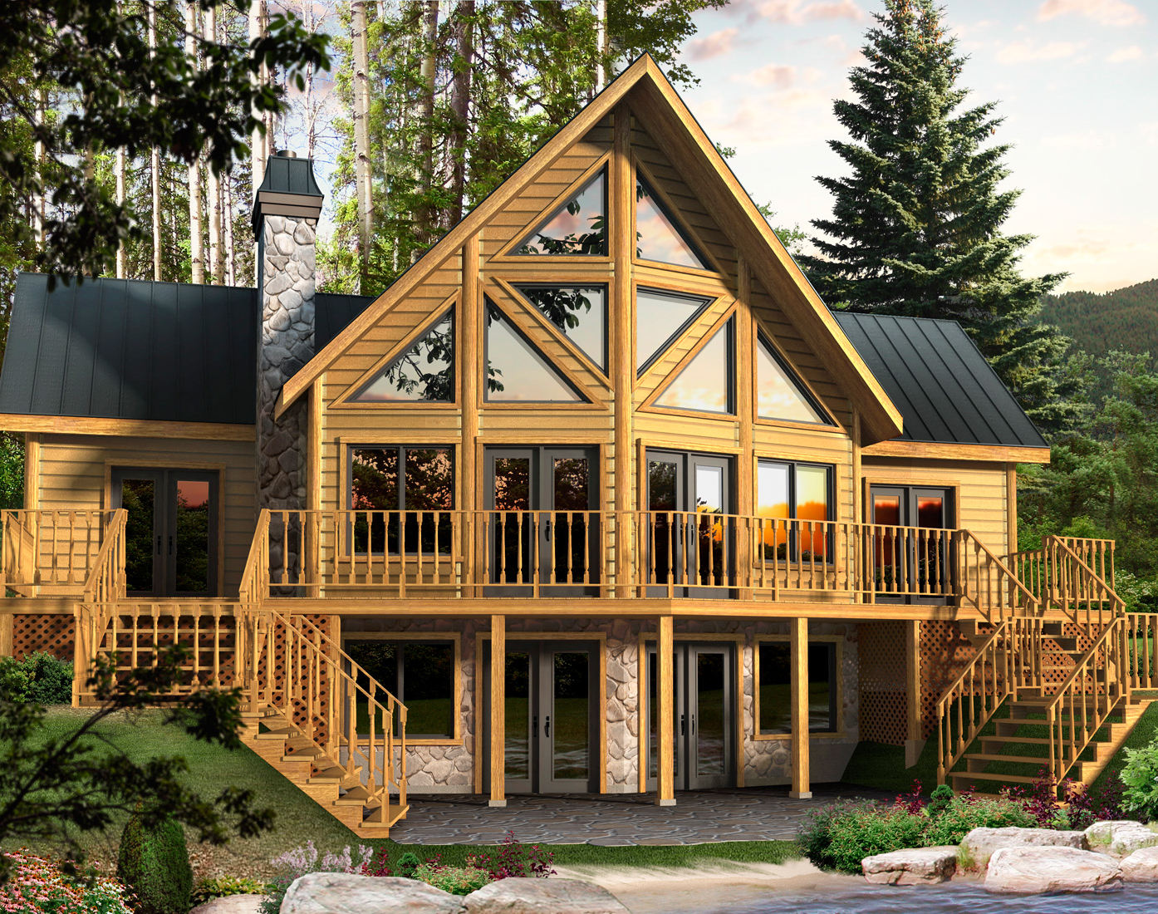
How can a bank help you achieve your dream?
There are many pieces to the puzzle when building a new home. Both Construction lending and permanent mortgages are important components needed to achieve the dream.
  New Century Bank specializes in both construction and permanent mortgages and provides a seamless solution to their clients.
  New Century has provided hundreds of Construction Loans, each one having some unique characteristic that required a special relationship between client and bank. Each one ending with a mortgage loan that paid off the construction loan.

Slide 3
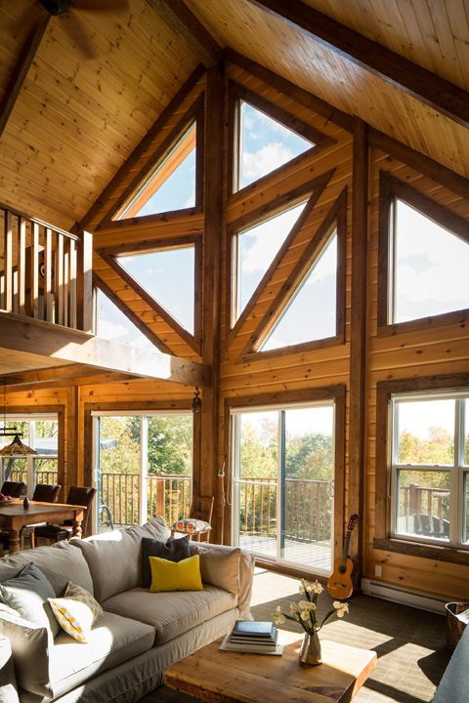
What is a Construction Loan?
And Do I need one?
A Construction loan is a Short Term loan, generally for up to one year which provides multiple advances which pay contractors and suppliers for material and labor. Only interest is paid during construction.
Permanent mortgage loans provide for a single advance to either: 1. refinance a mortgage loan on an existing home or 2. purchase an existing home.
Yes, everyone who builds a house must either procure a private loan from a bank or be restricted to a builder or developer who builds and sells completed homes usually within their own subdivision.
Customer designed homes and homes built on private land always need a construction loan when financing is needed
  New Century Bank construction loans allows you build on private land and the loan also may be used to procure the land itself. Clients only pay interest on the portion they borrow for the days borrowed.

Slide 4
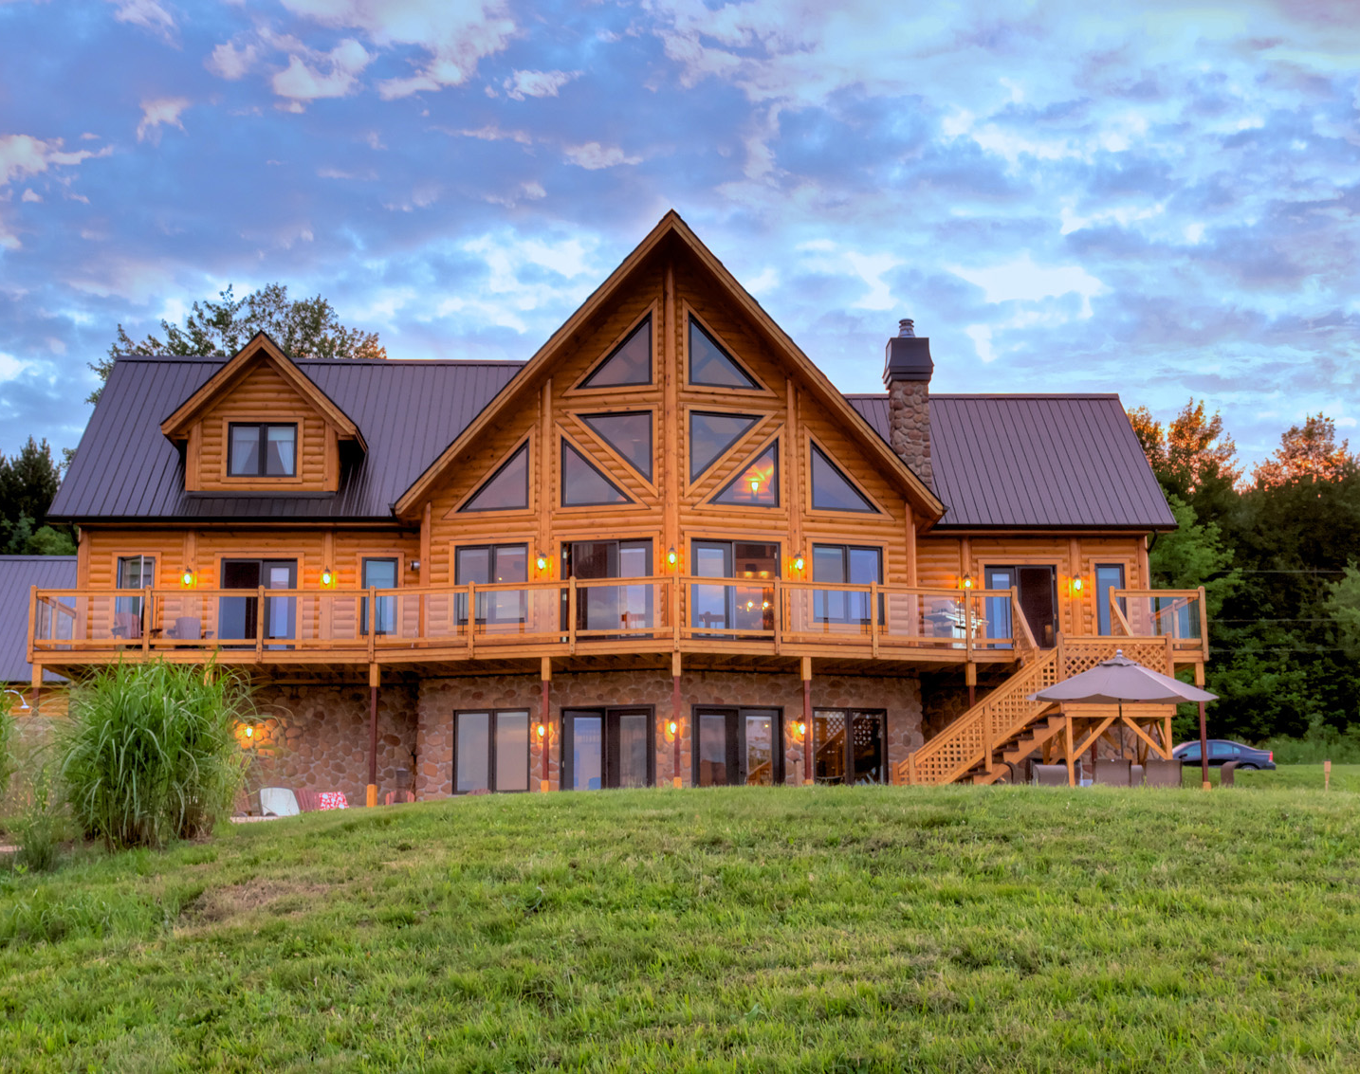
What is the lending process for building a new home?
How is it different from purchasing an existing home?
Items in red indicate different process
Prequalification application
Documenting the application
Finding Land and obtaining Construction bids
Appraisal (on subject to completion project)
Loan Commitment (both construction and Perm loan)
Close construction loan
Build the House
Close on Permanent
  New Century Bank provides all of these processes beginning with a two page application.

Slide 5
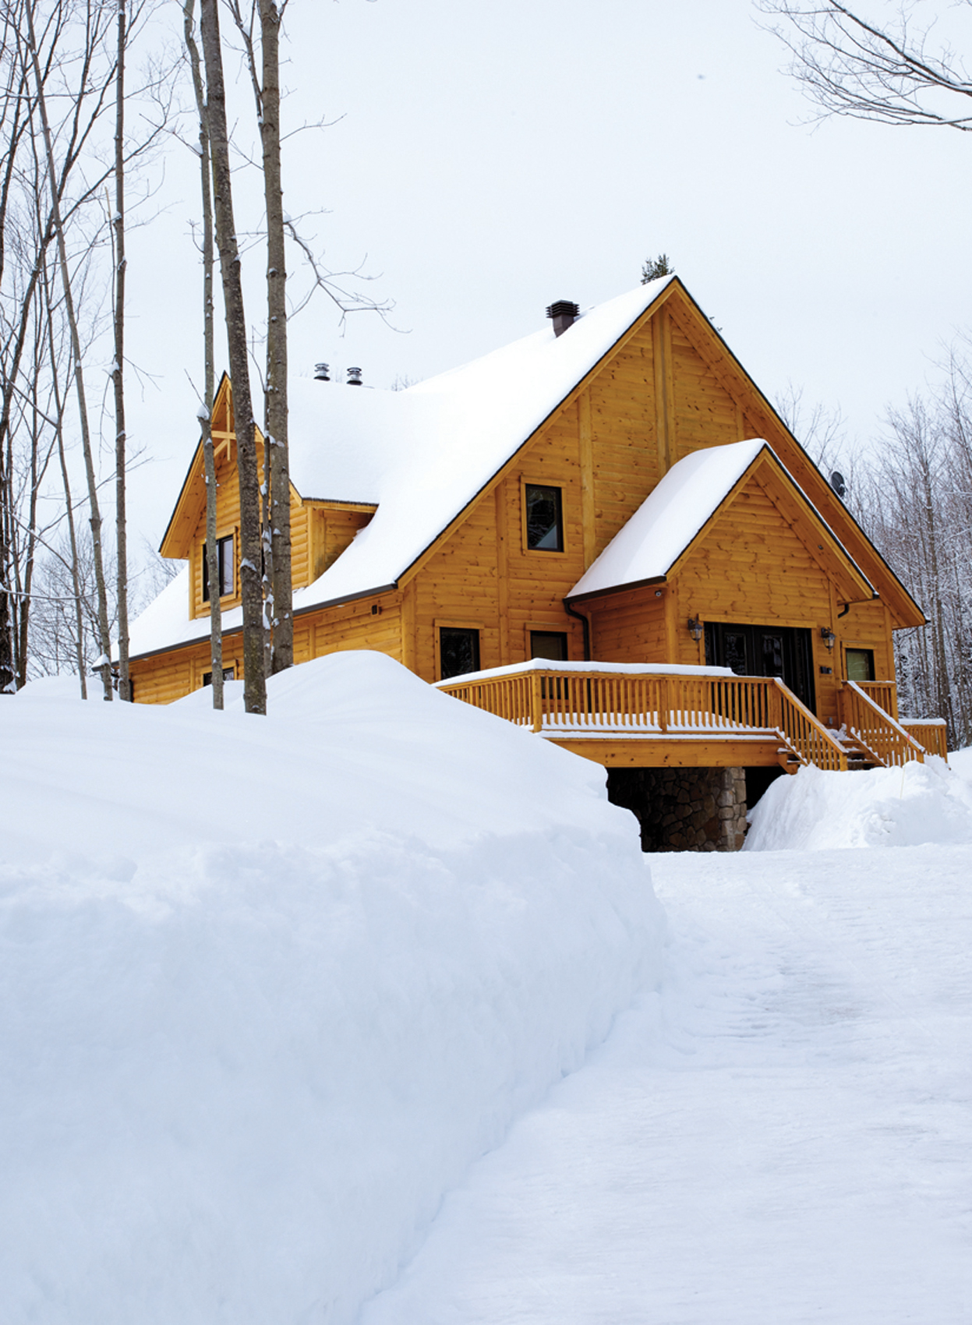
What construction costs may be included in the construction loan draws?
Land Purchase or land debt. (Some lenders will NOT allow draws for land purchase or payoff.)
Engineering and permits
Excavation and foundations and other site preparation
All Utilities delivery and hookup and driveways and roads
Contractor deposits (some construction lenders will not pay advance deposits)
Home package framing
Balance of home finish materials and labor
Basement finish
Appliances, decks, garage, landscaping, pool, hot-tubs, detached storage buildings and other items you may want.
  EVERY DETAIL within your budget is eligible for financing with New Century Bank less any required down payment. Clients may also be reimbursed for expenses paid prior to application.

Slide 6
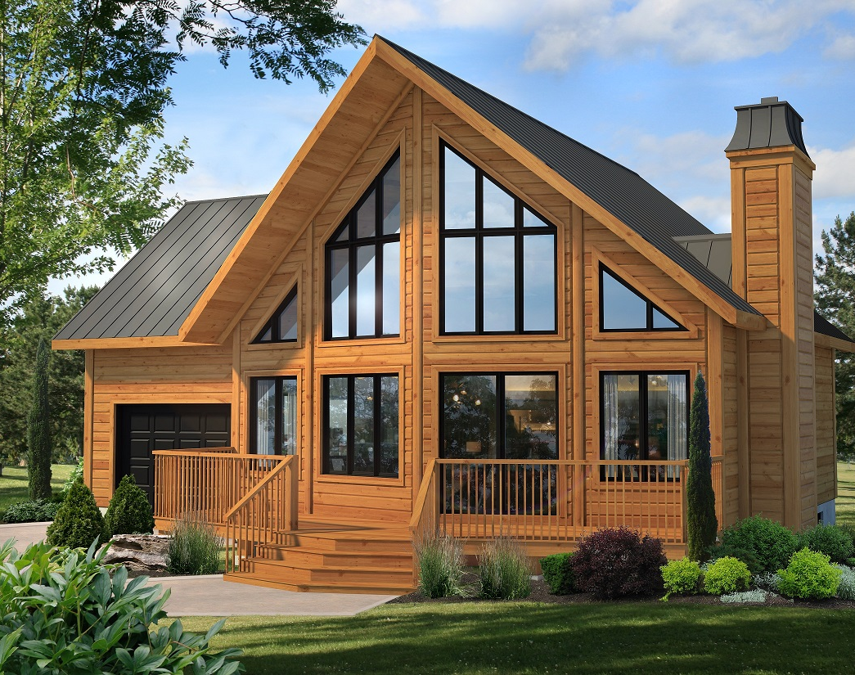
Are Lending qualifications different for a construction loan and the permanent mortgage?
Construction Loan are held inside a bank portfolio and therefore the Underwriting criteria must meet the construction lenders qualification requirements.
Permanent fixed rate mortgages provided by FNMA and FHLMC must qualify under their own Underwriting criteria.
Often these two differing guides conflict with a particular home owner’s life situation. Specifically:
LTV, (loan-to-value), a construction lender may require more down payment than the perm loan
credit score, construction lenders may require higher credit ratings on a construction loan
DTI, (debt-to-income) This math equation is sometimes prohibitive especially when a bridge loan is required.
  NCB approvals allow a client time to sell their home during or after construction and make the transition to the new home smooth. Some restriction apply

Slide 7
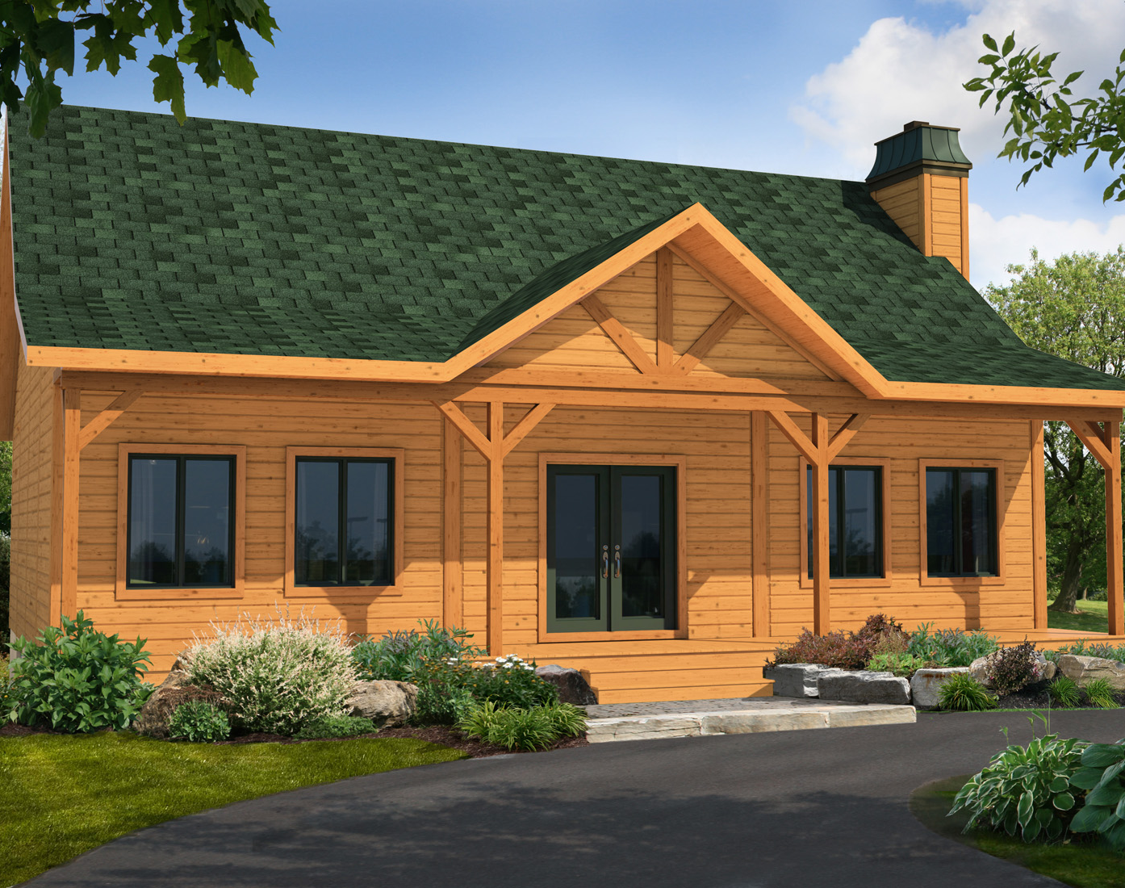
A. What is the minimum down payment?
B. Will I have two sets of closing costs
Any time a mortgage loan has less than 20% down payment, mortgage insurance is required, either PMI, private mortgage insurance or FHA, government mortgage insurance. Because mortgage insurance is not available for construction loans many lenders require 20% down payment or more.
Because there are two loans there will be two sets of closing costs.
  New Century Bank keeps closing costs low by not duplicating each cost. Savings are gained by utilizing the same Appraisal, Title insurance Company, insurance and escrow.

Slide 8
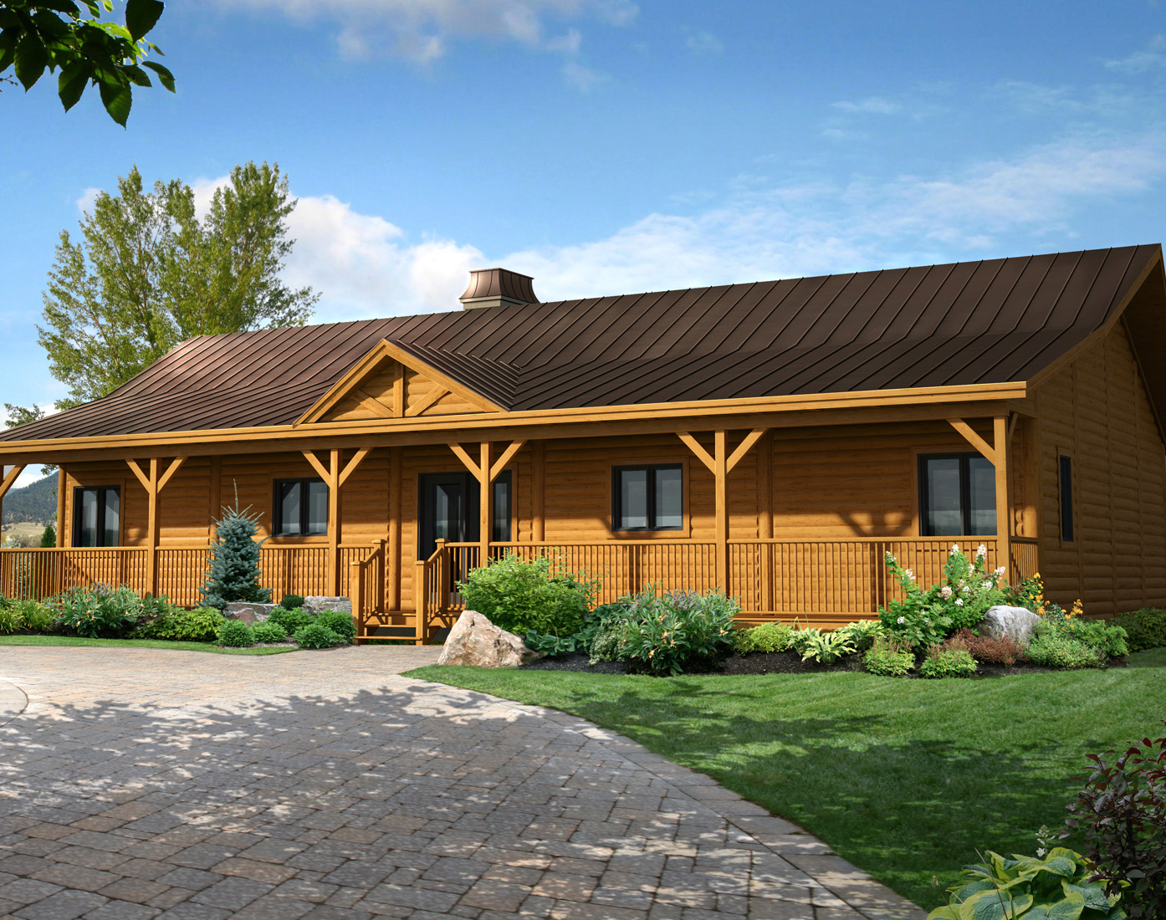
A. I own may land, will the equity count for a down payment?
B. Can I start construction prior to selling my existing home?
Land equity is the same as cash. The amount of equity is determined by the appraiser within the total value of the “subject-to-completion” appraisal obtained prior to start. Some Lenders do not count land value and require “cash only” down payments.
  New Century loans are based on the appraised value and if the appraisal is high enough, often times no cash is required from the client. FHA loans do require an accounting of cost and proving equity in cash or from land equity.
Building prior to selling an existing home can be an obstacle with many lenders. Home Owners wishing to use their existing home equity to build new creates the need for bridge financing. Many lenders will require an existing home to be sold and the cash paid in prior to start of the construction loan which could delay start times months.
  New Century construction loans may also function as a bridge loan by forecasting the equity and providing the temporary funds until the existing home is sold.

Slide 9
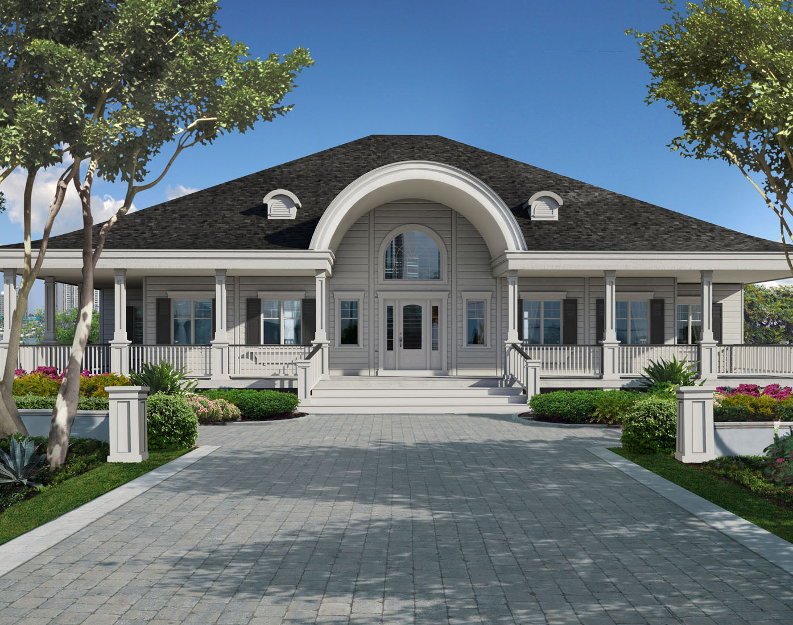
What are the interest rates?
When can I lock my interest rate?
Interest rates for construction loans are generally higher 1% - 2% than the FNMA 30 year fixed mortgage rate.
  New Century Bank has access to FNMA, FHLMC, FRMAC, FHLB and PORTFOLIO PERM. We provide access to the broadest spectrum of perm financing available. Our perm interest rates are in line with all the major money center banks retail operations.
To lock an interest rate, you must first have a completed home with final inspection and all lien waivers and invoices paid. Interest rate locks are free for 30 days and for a fee extended lock for 60 to 90 days.
  By using the same bank for both construction and permanent loan, New Century will coordinate the timing of final inspection and rate lock to move clients into the perm loan as quickly as possible. I do not recommend utilizing the extended rate lock feature.

Slide 10
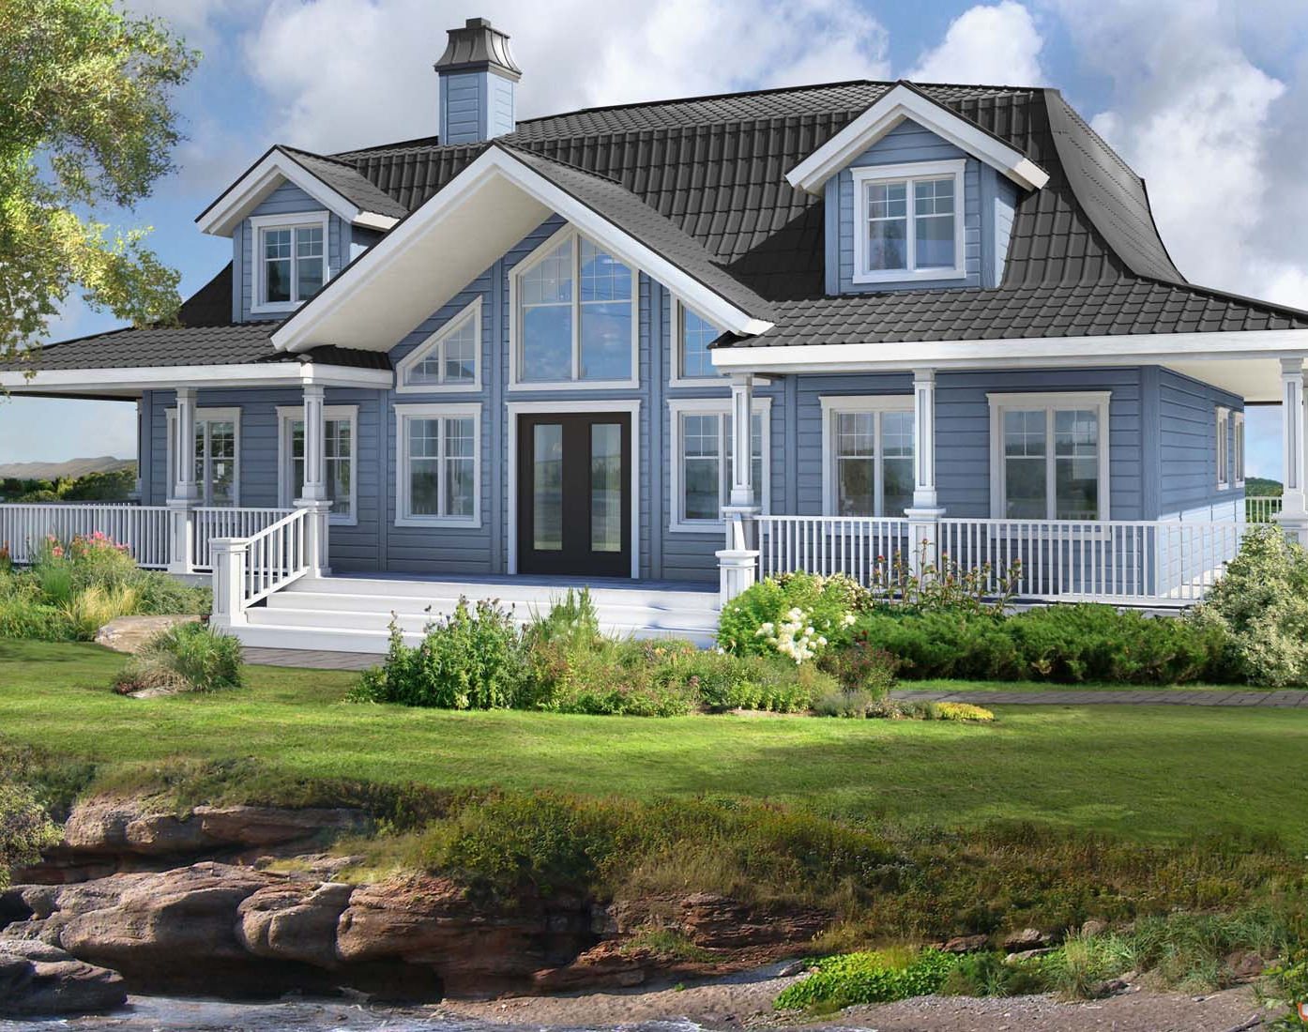
What are the keys areas in vetting a construction lender?
Experience: Clients will find New Century Bank’s experience with System Built construction-to-perm lending superior from start to finish. The application process and loan process is seamless
Knowledge of the Builders Product: Because our specialty is construction lending, we know your builder and his product. Our low down payment requirements are the best in the industry
Permanent Loan Commitment Maintenance: while many lenders wait until the home is complete to gain a loan perm loan commitment, we have found that method to pose many risks to the client.
Construction Draw Procedures: New Century feels that paying contractors quickly will keep building costs down and keep the construction crews on the job.
Custom Service: We have found that no two situations are the same. Therefore Custom Service is just as important as Customer Service.

Slide 11

Questions?
For more information regarding construction lending, call New Century Bank and speak to Alan Lierz, President or one of our new construction mortgage consultants
785-532-9066
Applications can be printed from our website
www.newcenturybankna.com

